Slide 1


Prediction on Injury Severity
MA0218 Presentation
Group 5: Buen Sung Jyun, Lee Min Xuan, Seah Yong Le Stanley, Tu Xia Yang
Notes:
Good Afternoon Prof, we are group 5 presenting on our Machine Learning Project.

Slide 2


Table of Contents
01
02
03
04
05
Data Preparation
Exploratory Analysis and Analytic Visualisation
Sample Collection
& Practical Motivation
Machine Learning & Statistical Inference
Intelligent Decision Outcome
Notes:
This is the table of contents.

Slide 3

01
Sample Collection
& Practical Motivation

Slide 4


Objective of our Project
Predicting Injury Severity
Notes:
Starting with the sample collection and practical motivation, our aim of our project is to predict injury severity in aviation accidents based on other factors in the dataset.

Slide 5


—Kheirallah Samaha
Data Used: Aviation Accident Database & Synopses
(up to Feb 2021)
Source: https://www.kaggle.com/datasets/khsamaha/aviation-accident-database-synopses
Description of data: https://www.ntsb.gov/_layouts/15/ntsb.aviation/AviationDownloadDataDictionary.aspx
Notes:
The data used is the aviation accidents database that is updated till February 2021

Slide 6

02
Data Preparation
Notes:
To achieve this, we will be applying multiple machine learning algorithms to identify the optimal estimator, however, first the dataset must be cleaned and structured

Slide 7
Dataset
Changing Data Types of Data
Extracting Predictors Needed
Replacing Null Inputs
Reindexing of Data
Notes:
87272 sets of data with 31 columns
describing aircraft damage on a scale of 0-3, with 3 being the most serious

Slide 8
Techniques used for Data Preparation
Imputing of Data
Putting in Median into null values based on skewness of Data
One-Hot Encoder
Preparation of Data for Machine Learning
Notes:
Null values needed to be replaced, for numerical predictors, we found that all of them were positively skewed, with a high amount of outliers, so we replaced them with the median of the data
We also used One-Hot Encoder, what this essentially does, it converts categorical data into binary data so machine learning algorithms can function properly.
each category within a variable into a new column, where it can be only be assigned a binary value of 1 or 0. Machine learning algorithms, such as decision trees, are able to take this data as there are only two classes.

Slide 9
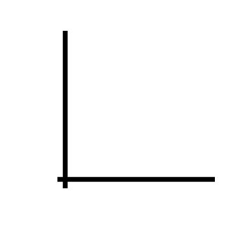
03
Exploratory Analysis & Analytic Visualisation

Slide 10
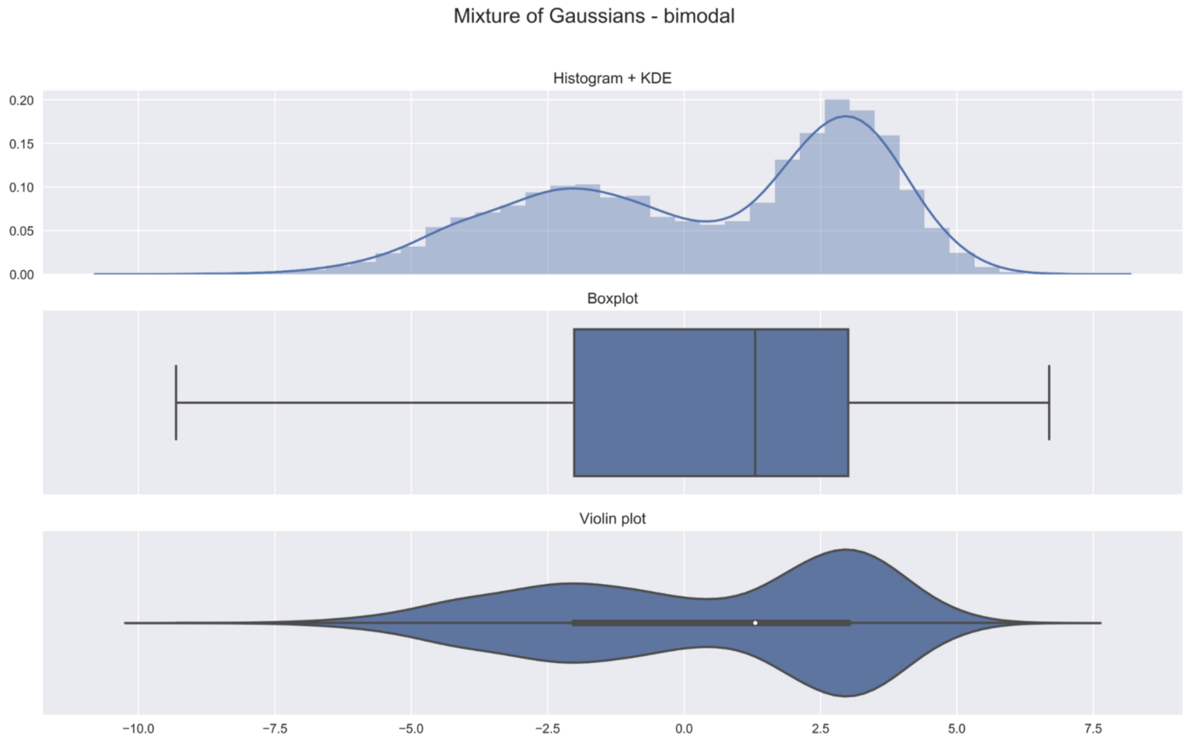
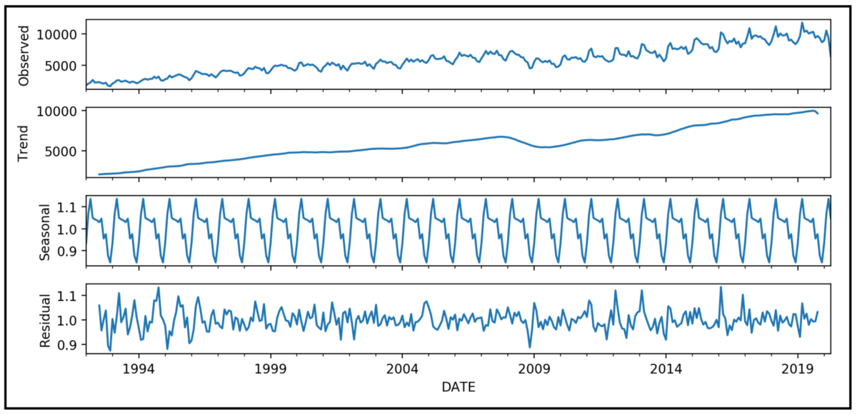
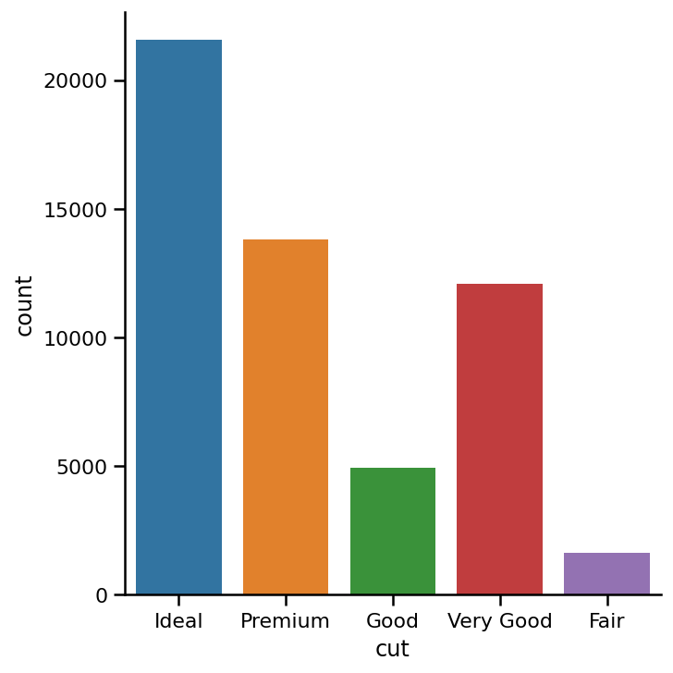
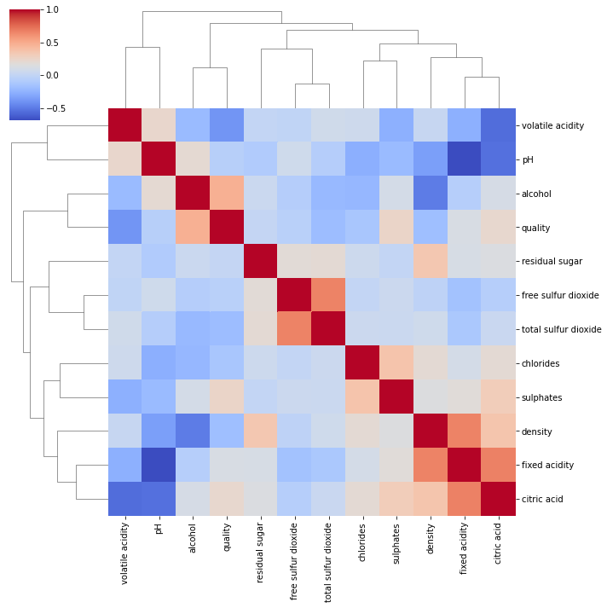
Types of Data Exploratory Techniques Used
Boxplot, Histplot, Violinplot
Time Series Decomposition
Cat Plots
Heatmaps

Slide 11
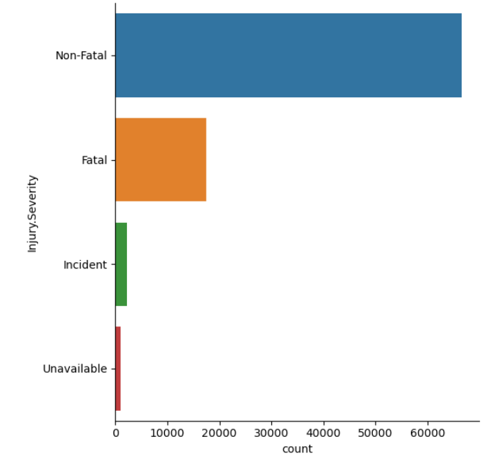
Response Variable: Injury Severity
Classifying Level of Injury Severity
Injury Severity | Total Number
Incident (1) | 2219
Non-Fatal (2) | 66561
Fatal (3) | 17523
Unavailable (0) | 979

Slide 12

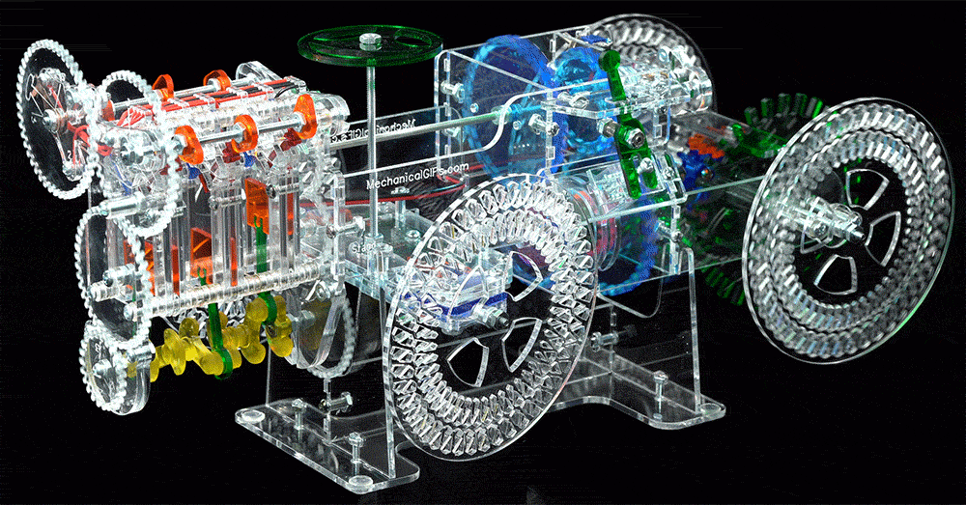
Numerical Predictors
Number of plane(s) involved
Number of engines

Slide 13
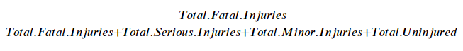
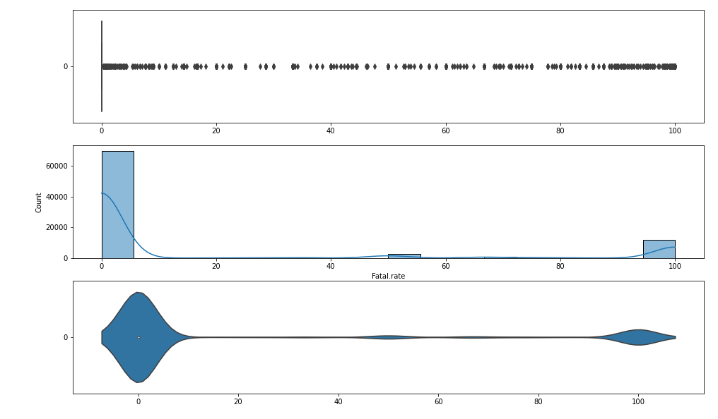
Fatality Rate

Slide 14
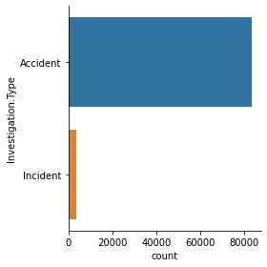
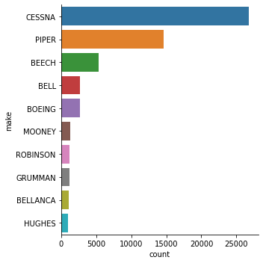
Categorical Predictors
Investigation Type
Make

Slide 15
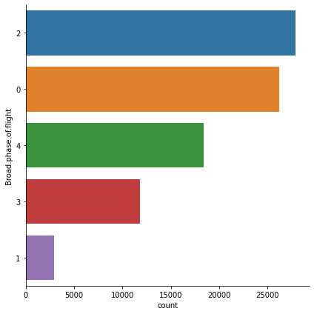
Categorical Predictors
Broad Phase of Flight
Phase of Flight | Phase Number
Taxi/Standing | 1
Takeoff/Landing | 2
Climb/Descent/ Approach/ Go-around | 3
Cruise/ Maneuvering | 4
Others | 0
Event Year
Amateur Built
Engine Type
Weather Conditions
Purpose of Fight

Slide 16
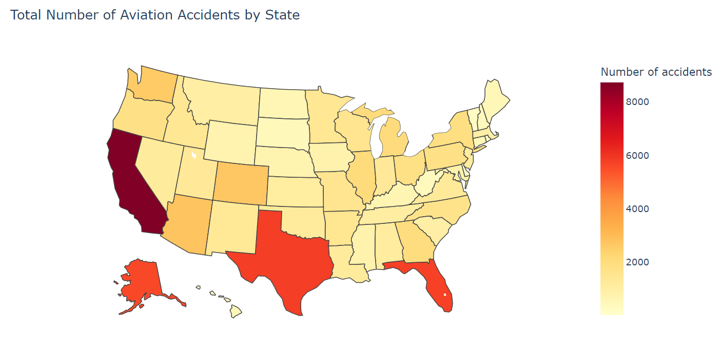
Total Number of Aviation Accidents in USA

Slide 17
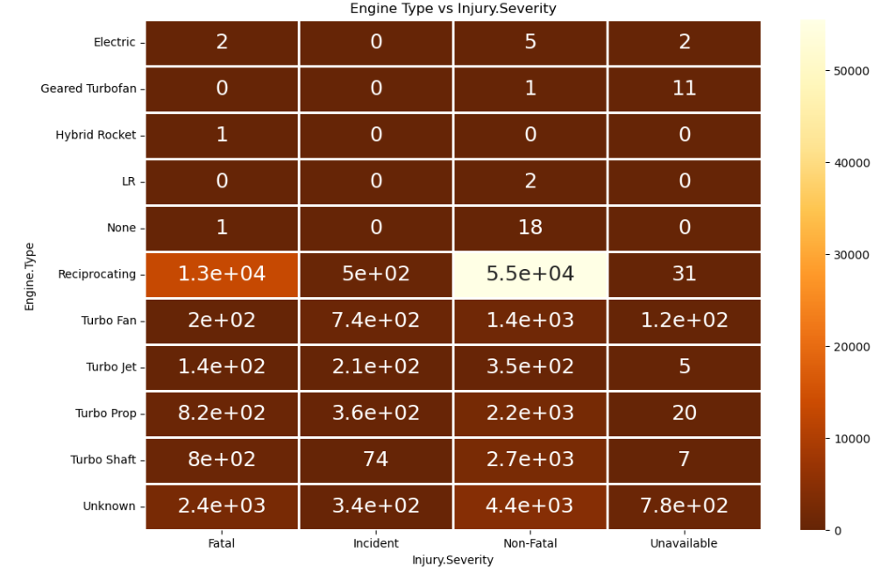
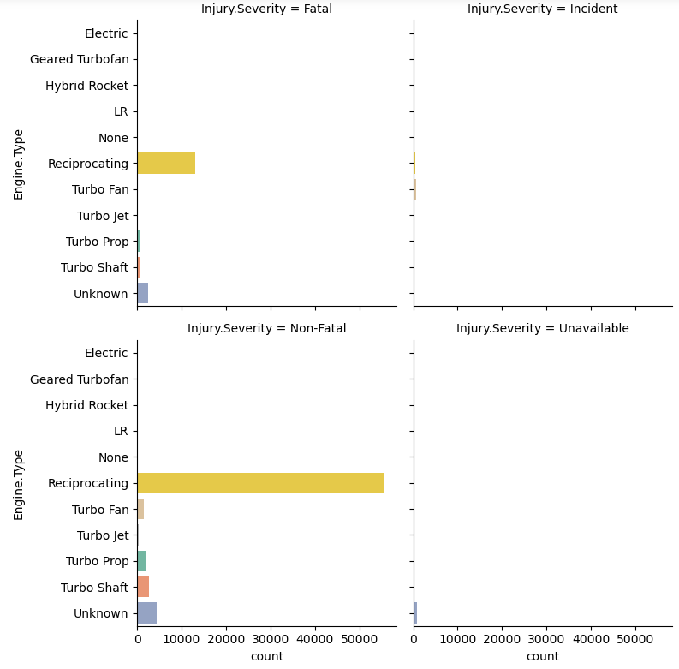
Plotting Injury Severity vs Engine Type
Reciprocating engine type
↑↑↑number aviation accident.
Turbo Fan was only used in 1980s
Most engines in the data are reciprocating engines

Slide 18

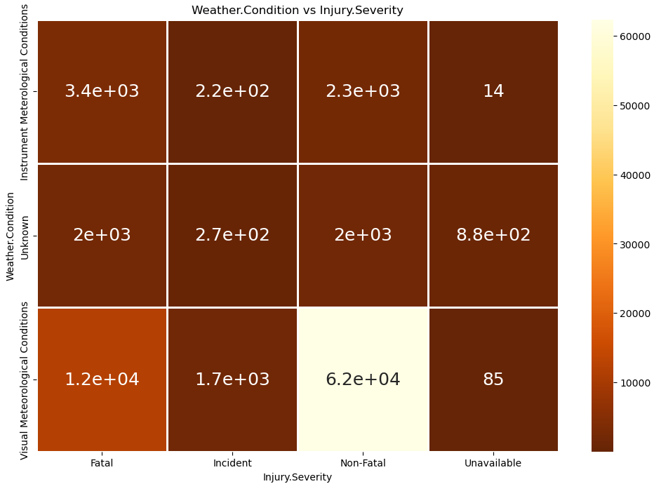
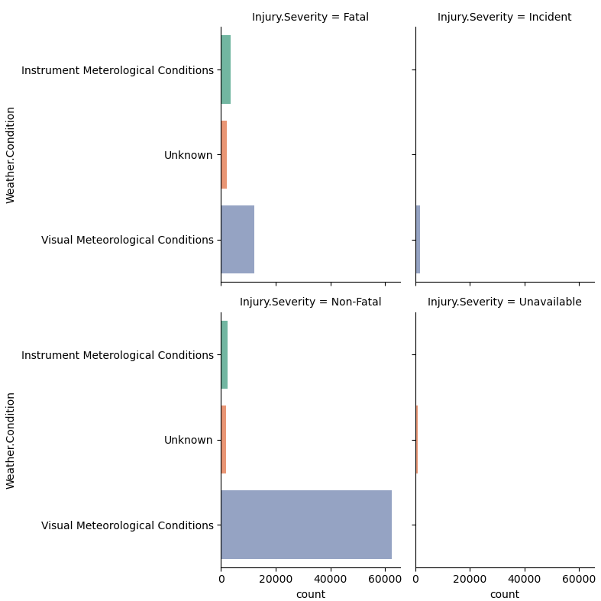
Plotting Injury Severity vs Weather Condition
Notes:
VMC (Visual Meteorological Conditions): Visibility more than 5km, cloudbase 1500 ft. Pilots can sufficiently and safely maintain visuals of all other aircraft and the terrain around them. (the grey bar)
IMC (Instrument Meterological Conditions): Any conditions worse than VMC, pilots need to rely on instruments. (the green bar)
Unk/UNK (Unknown): Weather condition unknown.
Notice that the weather condition of VMC has the highest amount of aviation accident.

Slide 19

04
Machine Learning & Statistical Inference

Slide 20
Machine Learning
Regression
Classification
Linear Regression
Decision Tree Classifier
Random Forest Classifier
Balanced Random Forest Classifier

Slide 21

Linear Regression
A supervised Machine Learning Algorithm that models a target prediction value based on independent variables

Slide 22
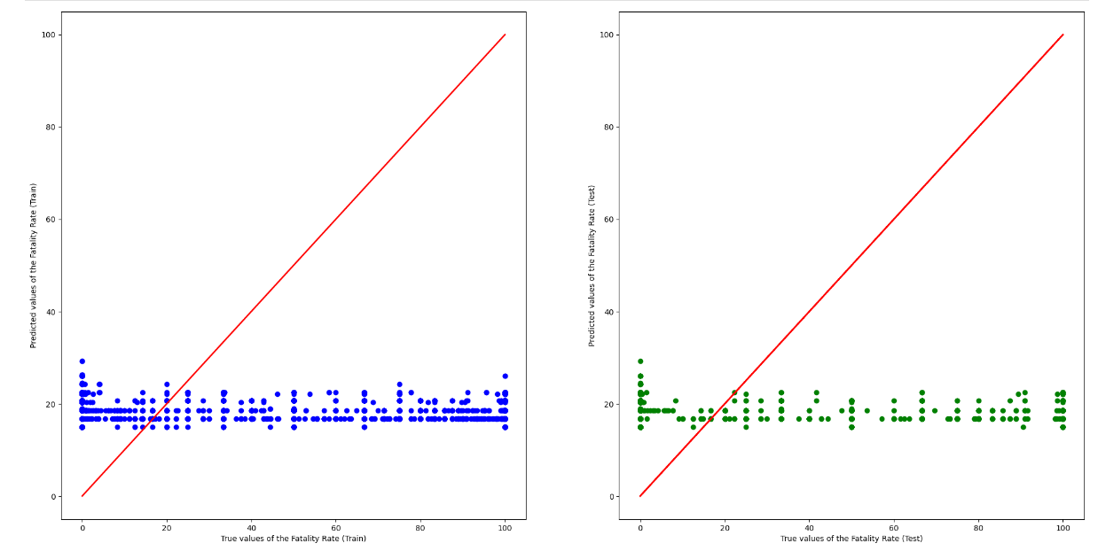
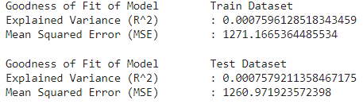
Linear Regression with Numeric Predictors
Notes:
Here we is the linear regression of the numerical response variable, fatality rate, using the numerical predictors (number of planes, and number of engines). The red line represents the prediction of fatality rate, while the scatter plot represents the true values of fatality rate.
We can see from both graphs that the goodness of fit is extremely bad, with mean squared error of over 1000, and explained variance less than 0.001 for both sets.

Slide 23
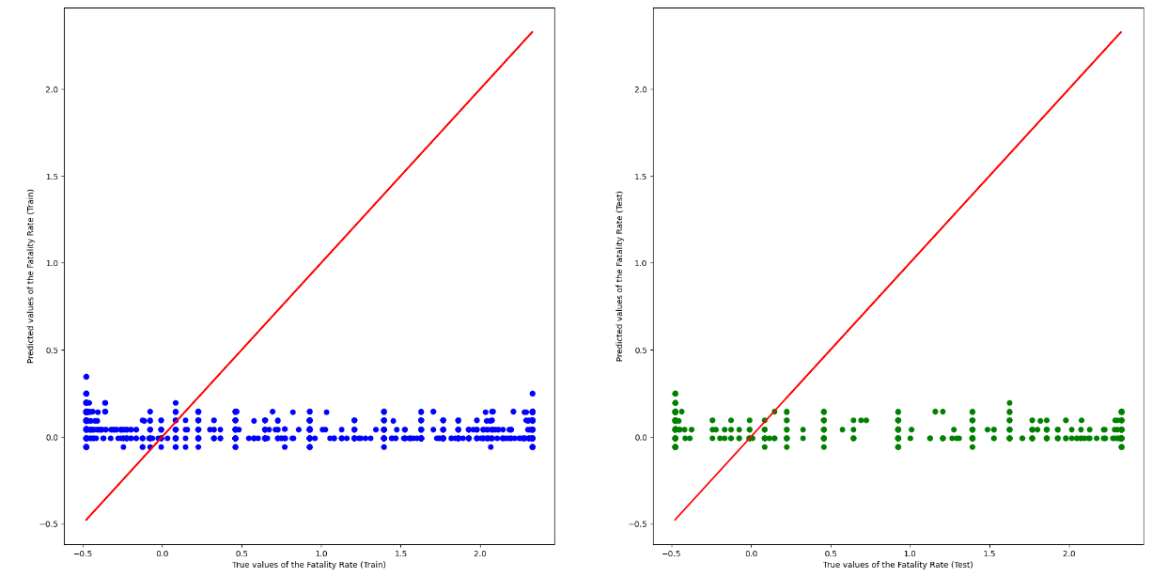
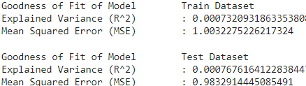
Linear Regression with Standard Scaler
Notes:
Here we have applied standard scaler to the numerical predictors, what this does is it standardizes variables by subtracting the mean and scales it to unit variance
essentially changing the mean to 0 and the standard deviation to 1
StandardScaler removes the mean and scales each feature/variable to unit variance. This operation is performed feature-wise in an independent way. StandardScaler can be influenced by outliers (if they exist in the dataset) since it involves the estimation of the empirical mean and standard deviation of each feature.
The idea behind the StandardScaler is that variables that are measured at different scales do not contribute equally to the fit of the model and the learning function of the model and could end up creating a bias.

Slide 24
Decision Tree Classifier
A supervised Machine Learning Algorithm that uses a set of rules to make decisions

Slide 25
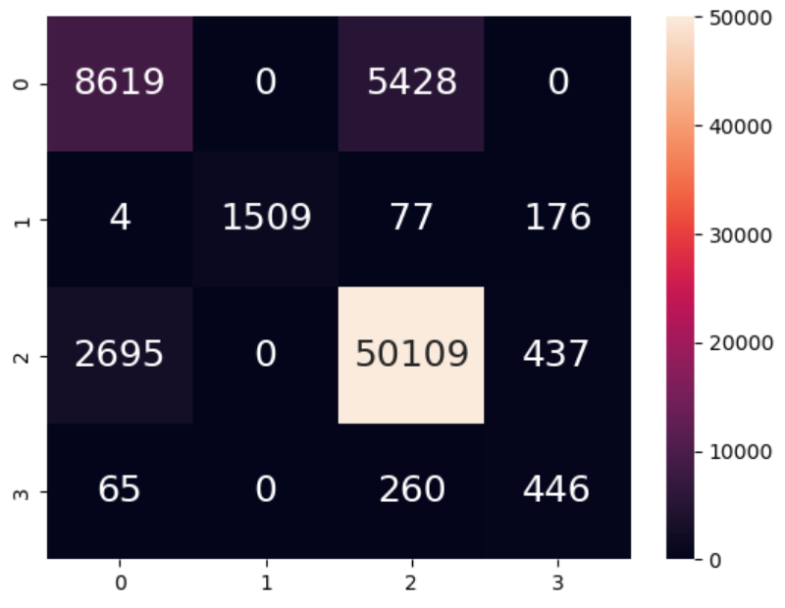
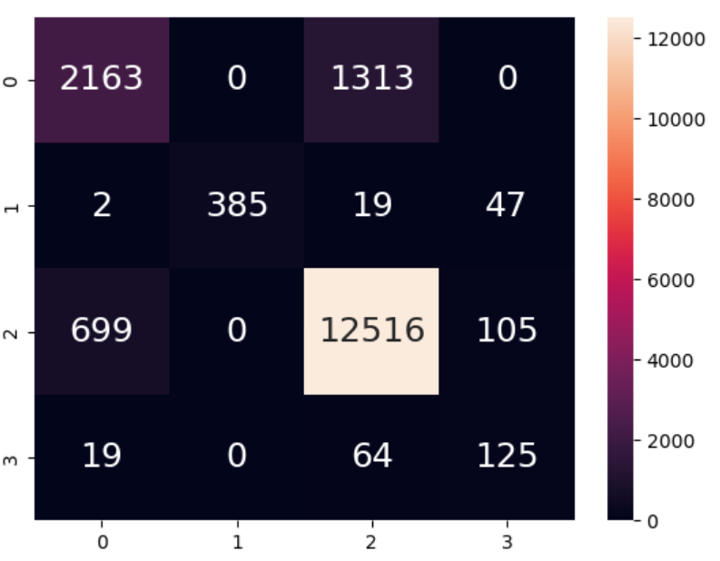
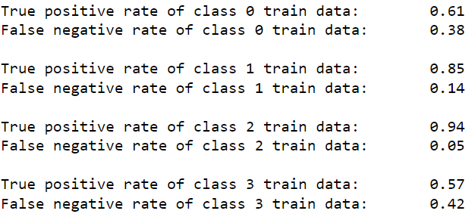
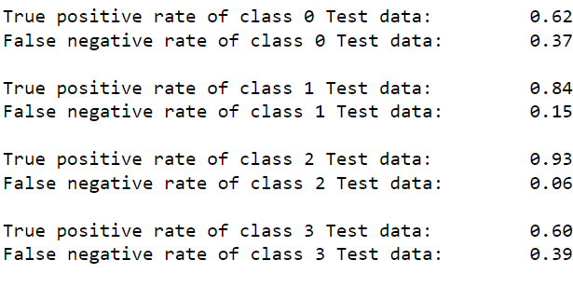
Decision Tree (initial Data)
Train Data
Test Data
BIAS!!!!!!!
Acc = 0.87
Acc = 0.87

Slide 26

How to Improve on the Tree?

Slide 27
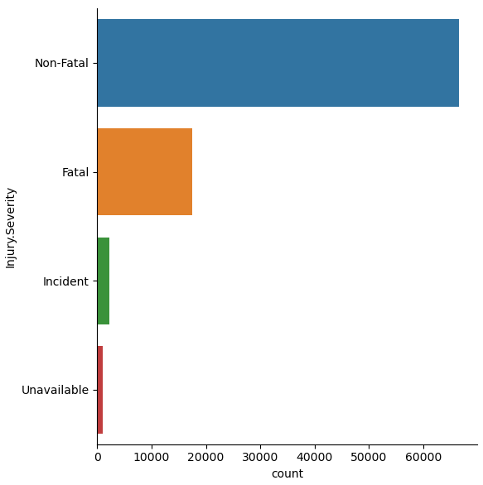
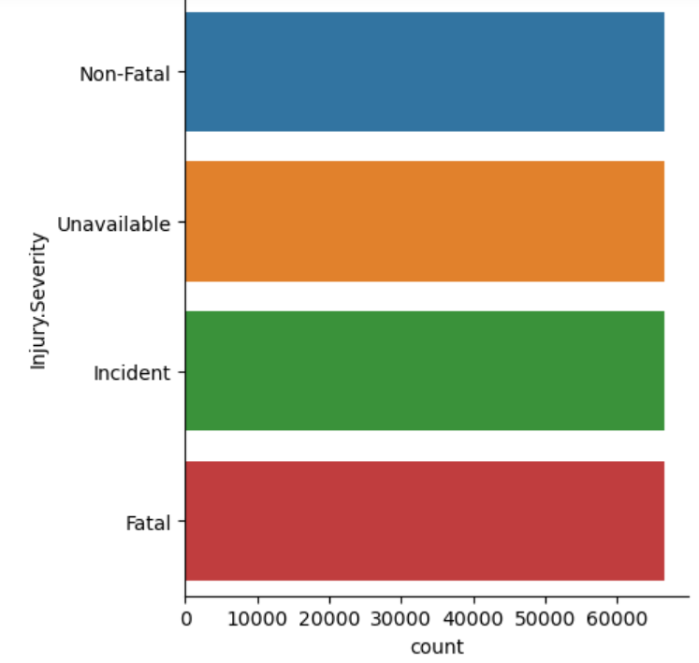
Resampling of data
Notes:
Resampling Data (Upsampling)
Used to address imbalance data, to reduce disparities in prediction accuracies between majority and minority classes.
However, may reduce prediction accuracy of majority class

Slide 28
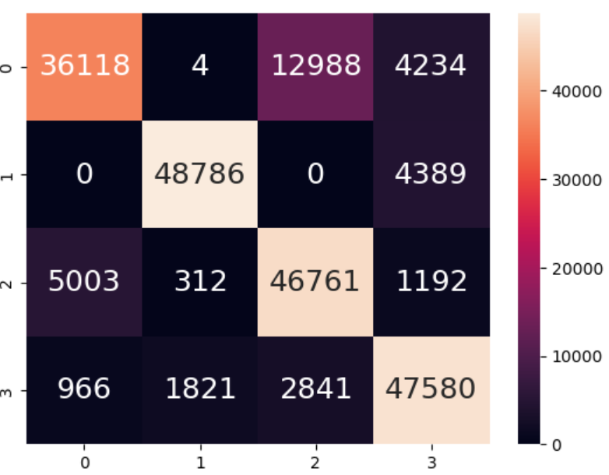
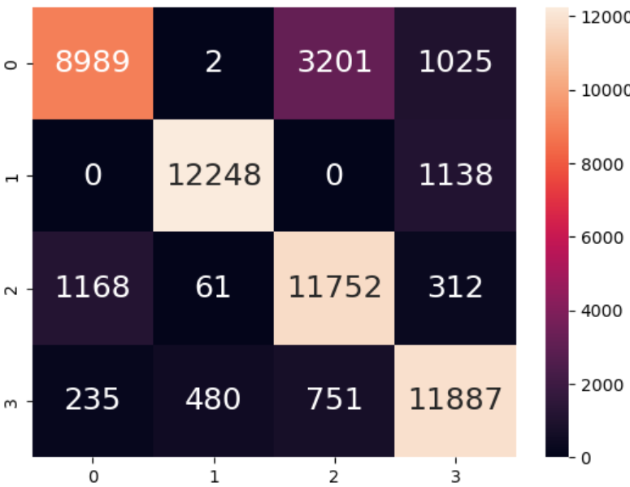
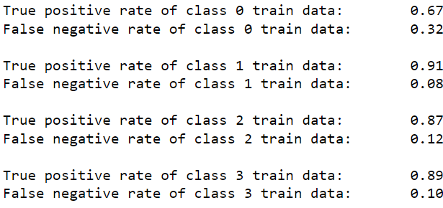
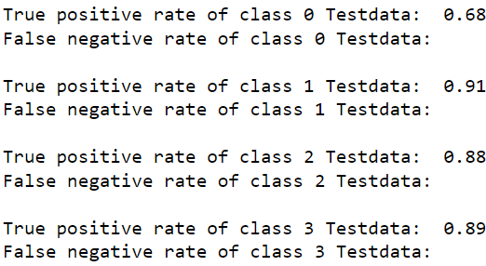
Upsampled Data Decision Tree
Train Data
Test Data
Acc = 0.84
Acc = 0.84

Slide 29

Cross Validation Technique
Using GridSearchCV
Max Depth: 2-10
10-fold cross validation
Accuracy set as the strategy
Best Depth of the Decision Tree is 9

Slide 30
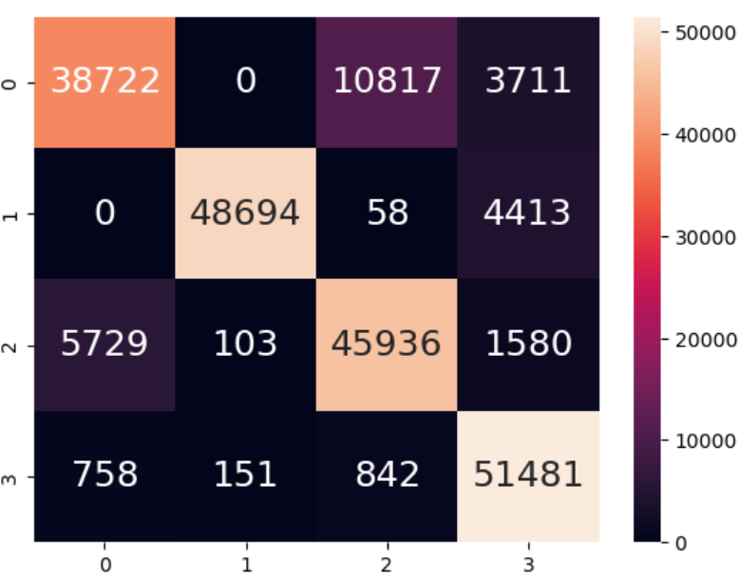
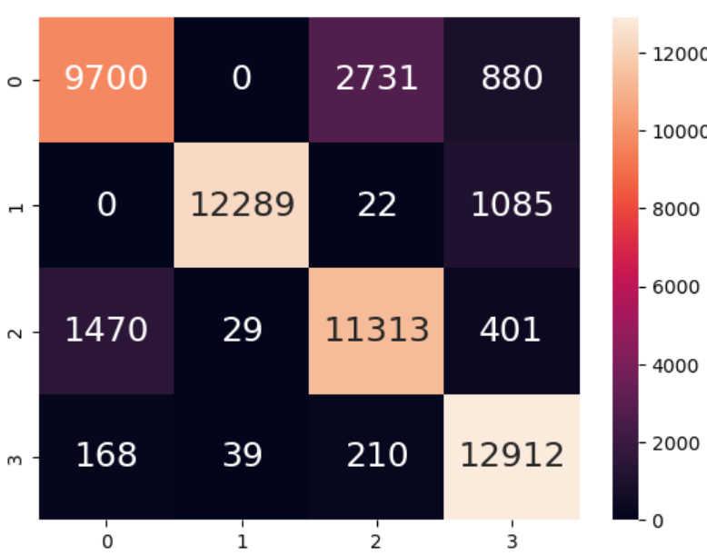
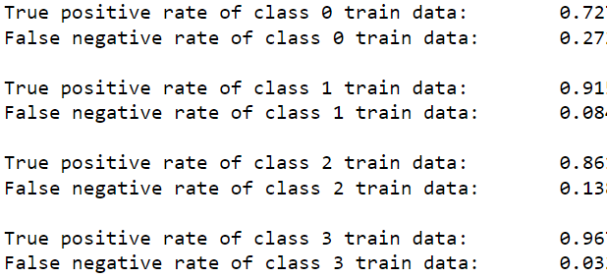
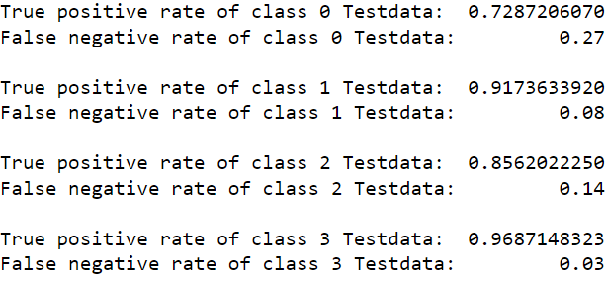
Decision Tree (Cross Validation)
Train Data
Test Data
Acc = 0.87
Acc = 0.87

Slide 31
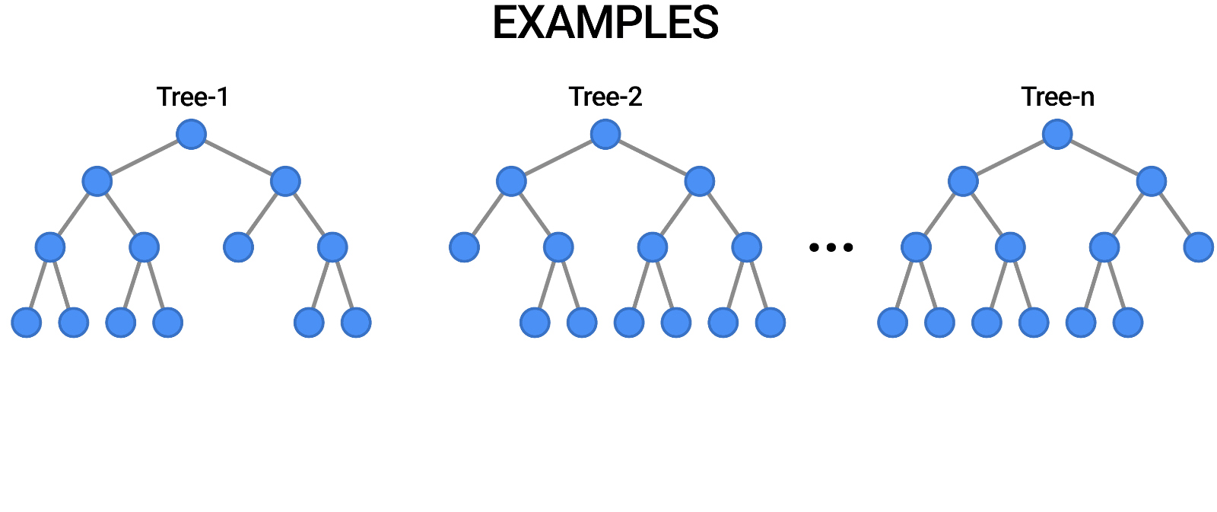
Random Forest Classifier
An estimator that fits multiple decision tree classifiers on different sub-samples of the dataset, utilising averaging to improve accuracy and prevent over-fitting
Notes:
Something new that our group did was the Random Forest Classifier, which is a meta estimator that fits a number of decision tree classifiers on various sub-samples of the dataset and uses averaging to improve the predictive accuracy and control over-fitting.
In our previous model, we only have one decision tree and now we will be having more decision tree, forming a forest

Slide 32
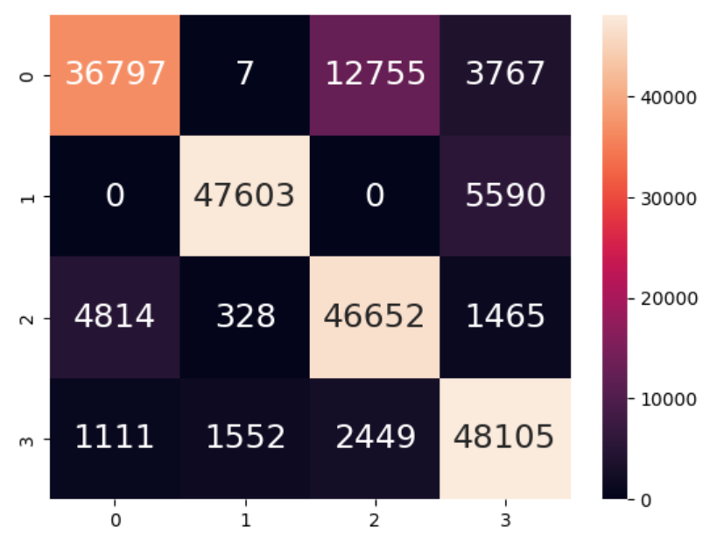
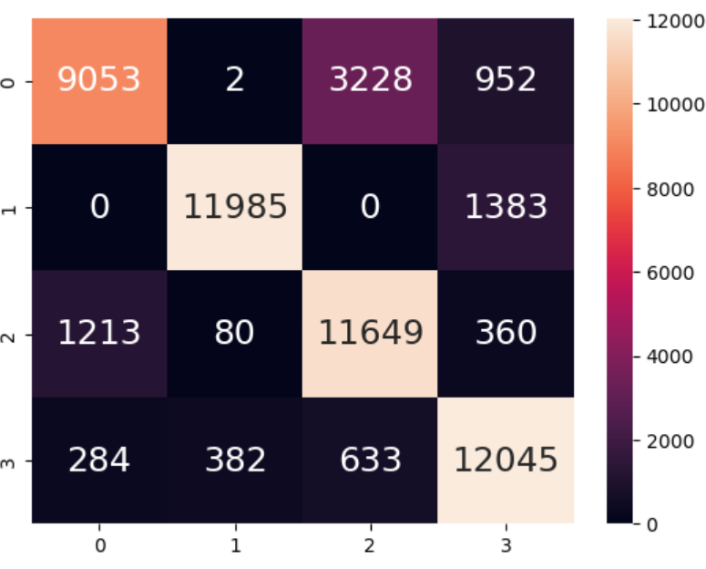
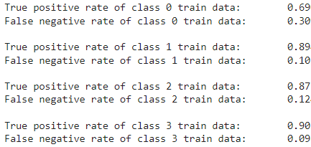
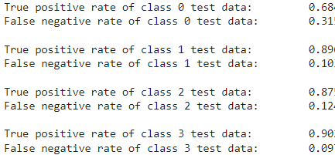
Random Forest Classifier
Used upsampled data
Train
Test
Acc = 0.84
Acc = 0.84
Notes:
This is the Random Forest Classifier that was generated based on upsampled data. The classification accuracy of the forest is similar to that of the decision tree generated using upsampled data, hence we decided we needed to improve the Forest model even further. \

Slide 33
How to Improve on the Random Forest?

Slide 34
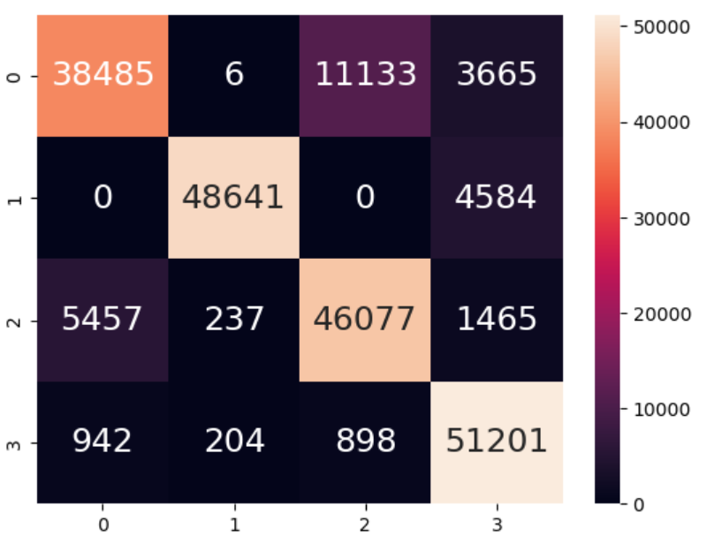
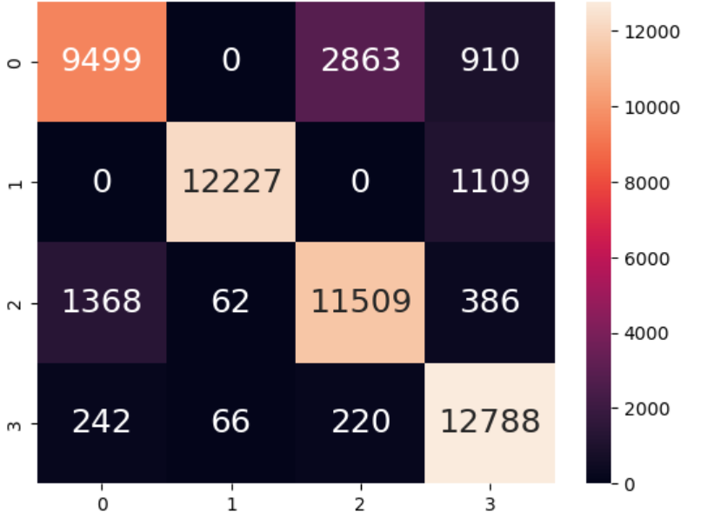
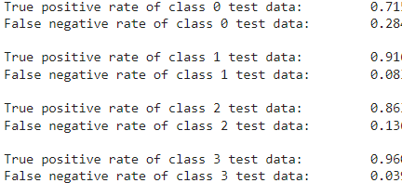
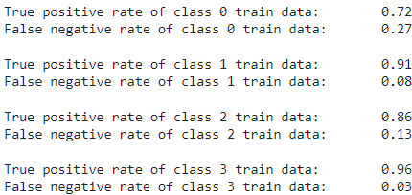
Random Forest Classifier (Cross Validated)
Train
Test
Acc = 0.87
Acc = 0.86
Notes:
The first thing we did was cross-validation, similar to the decision tree classifier, which improved the classification accuracy from 0.84 to 0.87

Slide 35
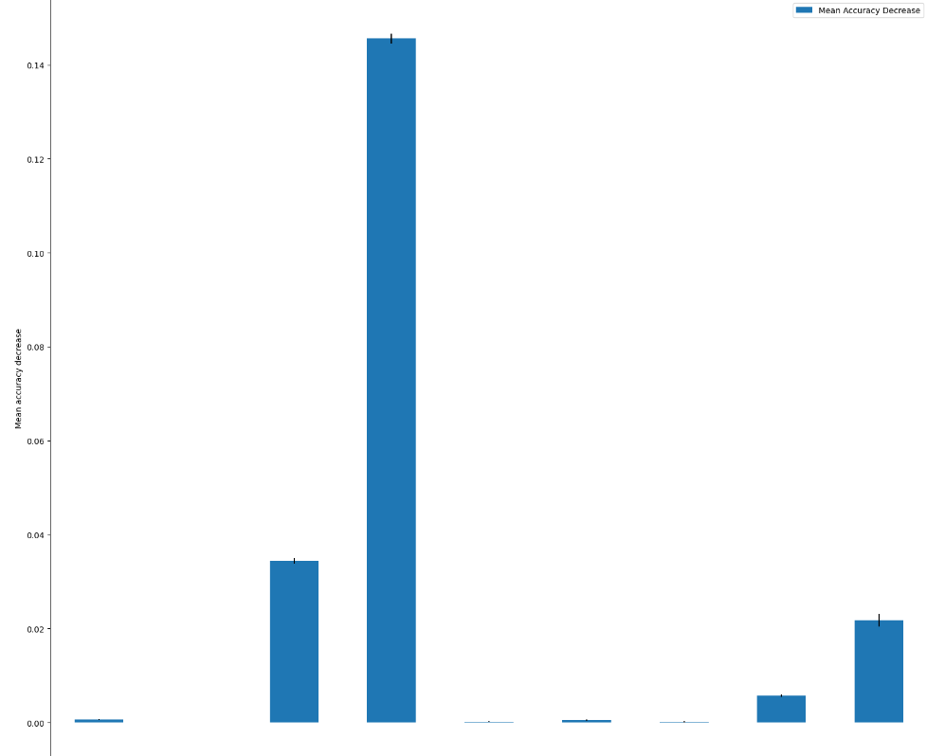
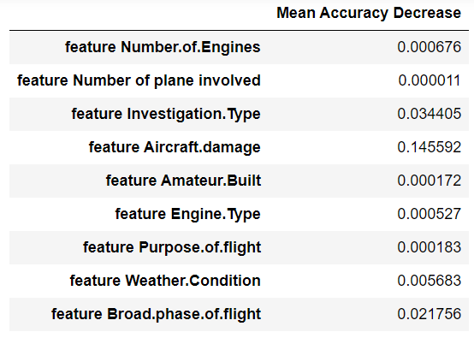
Ranking of Variables using Feature Importance
Notes:
Secondly, we also ranked the variables using permutation feature importance, which determines the importance of the variables based on the degree of change in the mean accuracy. The greater the change in mean accuracy, the more important is the variable.

Slide 36
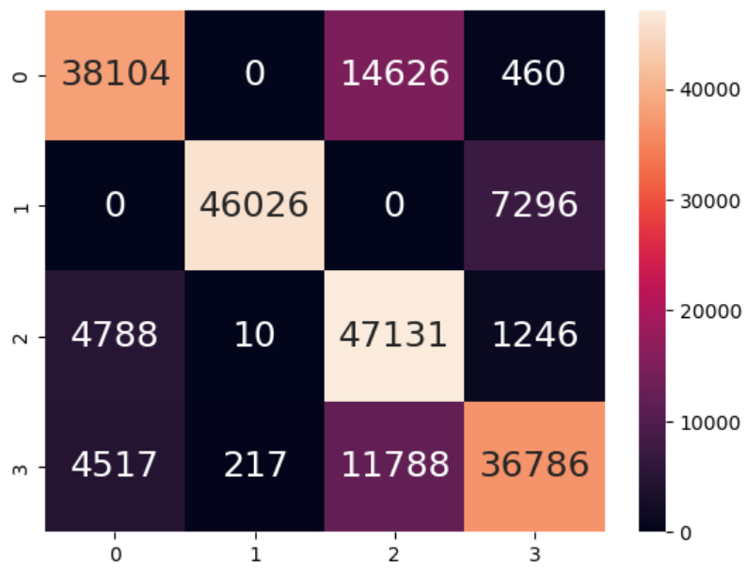
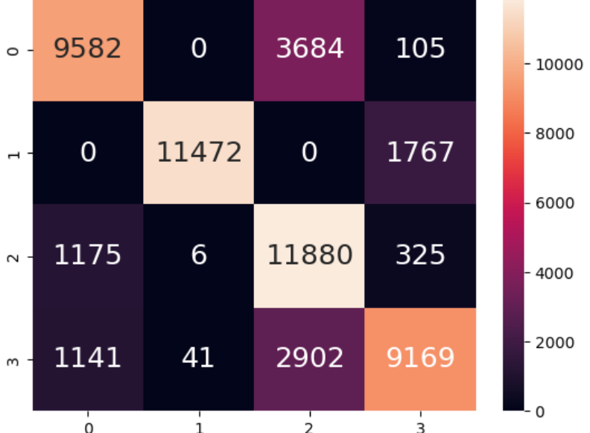
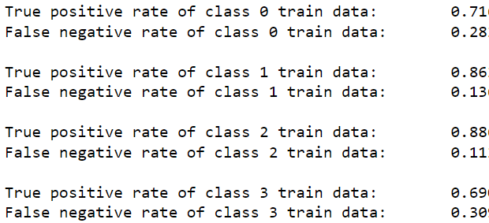
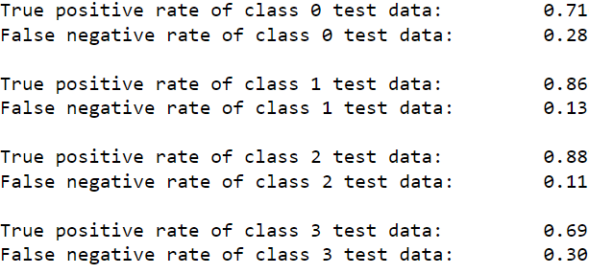
Random Forest Classfier (Feature Importance)
Train
Test
Acc = 0.79
Acc = 0.79
Notes:
Here is the heatmaps of the forest after the feature importance, which notably, decreased the classification accuracy. However, it is rather important that we had done the feature importance to better understand the relationship of the variables and the response variable so as to prevent overfitting of the random forest and improve on accuracy.

Slide 37

Balanced Random Forest Classifier
Model that uses “Ensemble Learning”, which refers to a group of base learners, or models, which work collectively to achieve a better final prediction.
Notes:
To try and further improve on our previous model, we also did a balanced random forest classifier. The balanced random forest classifier is designed in such a way that it allows us to handle unbalanced data without the need for any re-sampling. Therefore, in this case, the data used for this Forest is the one that has not been resampled. This ML technique makes use of ensemble learning, which refers to a group of base learners, or models, which work collectively to achieve a better final prediction.

Slide 38




Balanced Random Forest Classifier
Train
Test
Acc = 0.84
Acc = 0.83
Notes:
These 2 are the confusion matrixes that has been obtained from the train and test dataset respectively. While it is noted that the classification accuracy is similar to that of the previous models, the time taken to run the Balanced Random Forest Classifier is much shorter than the cross-validated forest model.

Slide 39

Time Series Analysis and Forecasting
Predicting number of fatal injuries
Notes:
Beyond random forest classifier, we explored accident prediction through time series analysis and forecasting.

Slide 40

Time Series Decomposition of Aircraft Accidents

Slide 41

Time Series Decomposition of Fatal Injuries
Notes:
- Data was reindexed based on the event date of accident
- After visualizing the data, we can see a downward trend and seasonal spikes throughout the year.

Slide 42
ARIMA
Autoregressive Integrated Moving Average
Used for time series forecasting
ARIMA models are denoted with the notation ARIMA(p, d, q)
Notes:
To predict the number of fatal injuries trend, we decided to use the ARIMA model, which stands for Autoregressive Integrated Moving Average, a commonly used method for time-series forecasting. The model is denoted by the 3 following parameters, which accounts for seasonality, trend, and noise in data.

Slide 43

Fitting the ARIMA Model for Number of Accidents
Summary of ARIMA model chosen based on lowest Akaike's Information Criterion (AIC)

Slide 44

Fitting the ARIMA Model for Number of Accidents
Diagnostics for the ARIMA Model

Slide 45

Validating Forecasts of Number of Accidents
To help us understand the accuracy of our forecasts, we compare predicted number of accidents to real number of accidents of the time series

Slide 46

Producing and visualizing forecasts

Slide 47

Fitting the ARIMA Model for Number of Fatal Injuries
Summary of ARIMA model chosen based on lowest Akaike's Information Criterion (AIC)
Notes:
The model was chosen based on the lowest AIC value, which is a criterion widely used to measure statistical models. (It basically quantifies 1) the goodness of fit, and 2) the simplicity/parsimony, of the model into a single statistic.)

Slide 48

Fitting the ARIMA Model for Number of Fatal Injuries
Diagnostics for the ARIMA Model
Notes:
The main assumptions for the prediction intervals for ARIMA models are that the residuals are uncorrelated and normally distributed. Thus, we run model diagnostics to ensure these criteria are met.
- Histogram and normal quantile-quantile plot shows that residuals are normally distributed
- Correlogram is a tool used to check for randomness of data set. If random, the graph will mostly show zero.
- For residuals, they are useful in checking whether a model has adequately captured the information in the data. A good forecasting method will yield residuals which are uncorrelated and have zero mean

Slide 49

Validating Forecasts of Number of Fatal Injuries
Notes:
To help us understand the accuracy of our forecasts, we compare predicted accident count to real counts of the time series.
On the graph, the blue line represents the actual number of fatal injuries whereas the red line shows the predicted number using one step ahead forecast which basically predicts the future number based on current data points. The grey area indicates the deviation of the prediction

Slide 50

Producing and visualizing forecast of Fatal Injuries
Notes:
Producing and visualising the forecast, the model predicts a general downward trend in number of fatal injuries. One of the limitations that we identify is that in real life application, the number of fatal injuries should not be negative.

Slide 51

05
Intelligent Decision Outcome
Notes:
To conclude

Slide 52


Our Findings
Balanced Random Forest Classifier was the best at predicting Injury Severity of Aircraft Accidents based on classification accuracy and biasness of data
There is a downward trend of Number of Accidents and Number of fatal injuries based on time series forecasting
Notes:
here are some of the findings of our project
- Balanced Random Forest Classifier was the best at predicting Injury Severity of Aircraft Accidents based on classification accuracy and biasness of data
- There is a downward trend of Number of Accidents and Number of fatal injuries based on time series forecasting

Slide 53
New Things We Learnt
Preparing of Data
Resampling, OneHotEncoder,
Standard Scaler
Cross Validation
(Grid Search)
Random Forest Classifier
Balanced Random Forest Classifier
ARIMA Model
Time Series Analysis
Notes:
And some of the new things we learn are
- Methods for preparing data
- Cross validation
- Random forest classifiers
- ARIMA model

Slide 54
Work Allocation
Min Xuan
Xiayang
Time Series Analysis (Number of accidents)
Slides
Exploratory Data Analysis
Classification Machine Learning
Slides
Sung Jyun
Stanley
Time Series Analysis (Number of fatal injuries)
Slides
Linear Regression
Slides

Slide 55

Thanks!
Do you have any questions?
Please keep this slide for attribution

